Slide 1
A Novel Multicellular Computer

Slide 2
Design challenges for protein engineering
Protein networks
De novo heterodimers
Ligand/pH mediated or disrupted binders

Slide 3
New design challenges for protein engineering
Protein networks
De novo heterodimers
Experimental screening is still necessary
YSD
Y2H
BLI
Library-on-library
✗
✓
✗
Ligand/pH mediated or disrupted binders
Quantitative
✓
✗
✓
Controllable environment
✓
✗
✓
Boder, Eric, et al. (1997) Nature Biotechnology 15.6: 553-557.
Yu, Haiyuan, et al. (2011) Nature Methods 8.6: 478-480.
Fields, Stanley, et al. (1989) Nature 340.6230: 245-246 .

Slide 4
New design challenges for protein engineering
Protein networks
De novo heterodimers
Synthetic Agglutination
Ligand/pH mediated or disrupted binders

Slide 5
Yeast agglutination and mating
MATa
MATα
Aga2
Sag1
MATa
MATα
Zhao, Hui, et al. (2001) Journal of Bacteriology 183.9: 2874-2880.
Herskowitz, Ira. (1988) Microbiological Reviews 52.4: 536-553.

Slide 6
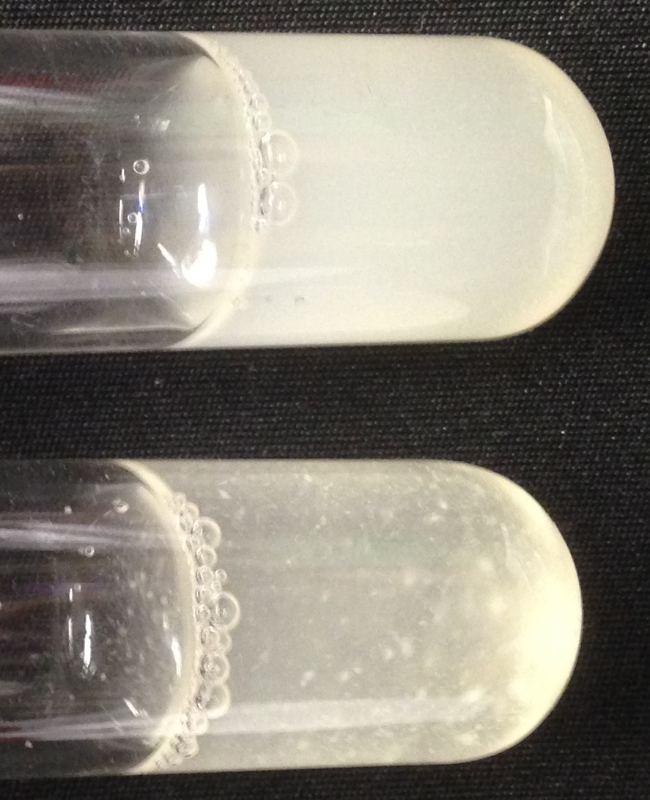
Yeast agglutination and mating
MATa
MATα
MATa
&
MATα
MATa
Aga2
Sag1
MATa
MATα
Zhao, Hui, et al. (2001) Journal of Bacteriology 183.9: 2874-2880.
Herskowitz, Ira. (1988) Microbiological Reviews 52.4: 536-553.

Slide 7
Yeast agglutination and mating
MATa
MATα
Aga2
Sag1
MATa
MATα
Diploid

Slide 8
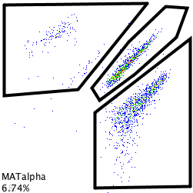
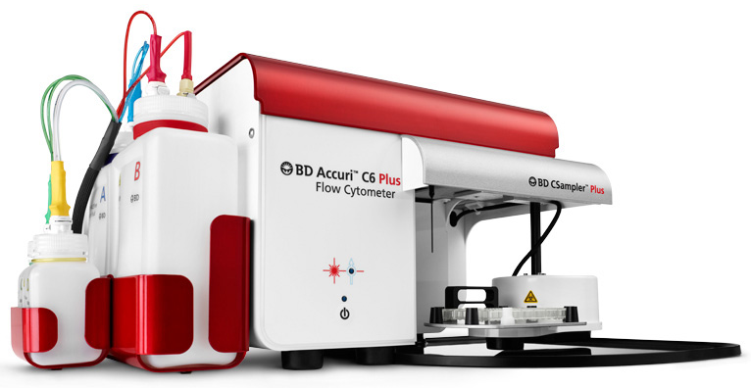
Quantifying yeast mating
Aga2
Sag1
MATa
MATα
MATα
MATa
MATα
Log(mTurquoise fluorescence)
Diploid
Diploid
MATa
Log(mCherry fluorescence)
Diploid
Mating Efficiency =
Total

Slide 9
Expressing proteins on the yeast surface
pGPD
Aga1
Aga1
Boder, Eric, et al. (1997) Nature Biotechnology 15.6: 553-557.

Slide 10
Expressing proteins on the yeast surface
myc
pGPD
Aga1
S
Aga1
Aga2
S
pGPD
Aga2
myc
Synthetic agglutinin protein
Boder, Eric, et al. (1997) Nature Biotechnology 15.6: 553-557.

Slide 11
Expressing proteins on the yeast surface
myc
pGPD
Aga1
S
Aga1
Aga2
S
pGPD
Aga2
myc
MATα strain not shown

Slide 12
Expressing proteins on the yeast surface
FITC
Y
myc
pGPD
Aga1
S
Aga1
Aga2
S
pGPD
Aga2
myc

Slide 13
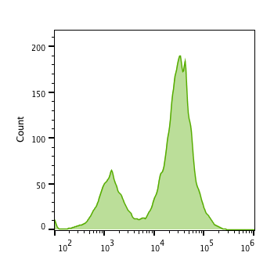
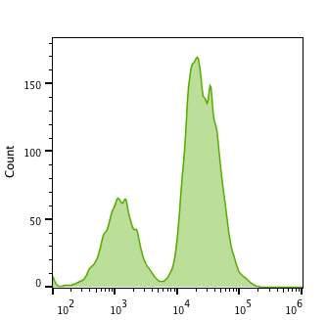
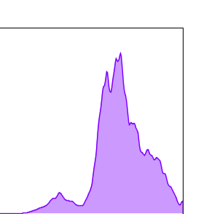
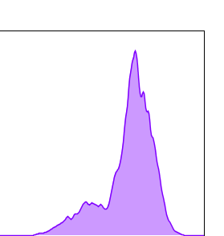
Expressing proteins on the yeast surface
MATa
MATα
FITC Fluorescence (au)
FITC Fluorescence (au)
Traditional YSD (plasmid and GAL induction)
Modified YSD (integrated and constitutive)

Slide 14
Testing synthetic agglutination
Aga2
Sag1
MATa
MATα
Grow cells separately
Combine cells in YPD media (2x MATα)
MATa
MATα
Diploid
Incubate for 17 hours
Measure on cytometer

Slide 15
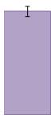



Testing synthetic agglutination
MATa
MATα
MATa
MATα
57.1%
± 0.2%
Mating Efficiency
51.6%
± 7.9%
0.3%
± 0.5%
0.1%
± 0.1%
Diploid
WT
Knockout
Match
Mismatch
Sag1
Aga2

Slide 16
Test case for quantitative characterization
BCL2 apoptosis regulators (pro-survival)
Bfl-1
Bcl-B
Bcl-2
Bcl-xL
Bcl-w
Bad
αBFL1
F30D
αBCLB
de novo
binders
designed by
Baker lab
10,000
BCDP01
BECM04
αBCL2
1,000
2CDP06
XCDP07
K_{D} (nM)
100
Berger, Stephanie, et al. (2016) eLife 5: e20352.
10
1
Notes:
The Bcl-2 Family (TC# 1.A.21) consists of a number of evolutionarily-conserved proteins that share Bcl-2 homology (BH) domains. The Bcl-2 family is most notable for their regulation of apoptosis, a form of programmed cell death, at the mitochondrion. The Bcl-2 family proteins consists of members that either promote or inhibit apoptosis, and control apoptosis by governing mitochondrial outer membrane permeabilization (MOMP). A total of 25 genes in the Bcl-2 family were identified by 2008.^{[2]}

Slide 17
Test case for quantitative characterization

Slide 18
What Can You Compute?

Slide 19
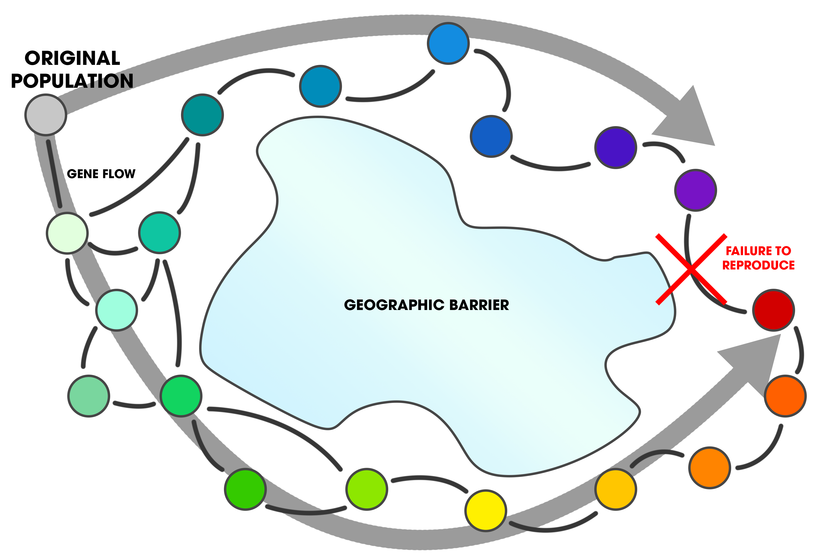
Ring Species

Slide 20
Computational Toolkit
a₁
(Fast)
a₁
D_{1|1}
D_{1|1}C_{(1,1)}
α₁
α₁
(Slow)
a₁
a₁
D_{1|1,2}
D_{1|1}
α_{1,2}
α₁
D_{2|1,2}
a₂
a₁
Ø
a₁
α₁
D_{1|1}C_{(2,1)}
α₁
a₁
a₁
a₂
D_{2|1}
D_{1|1}
or
a₂
α₁
α₁
α₃
a₁
and/or
α₁
and/or
D₁
Auxin, cytokinin, mating factors
C_{(1,2)}
a₁
and/or
Any genes
D_{1|2}
α₂

Slide 21
Computational Toolkit
a₁
α₁
D_{1|1}
a₁
1
1
1
AND
D_{1|1}
α₁
1
0
0
0
1
0
0
0
0
a₁
a₂
D_{1|1,2}
D_{1|1,2}
NOT
α_{1,2}
0
Ø
1
a₂
0
1
a₁
a₁
α₁
D_{2|2}
D_{1|1}C_{(4,2)}
α₁
1
1
0
NAND
a₂
1
0
1
D_{2|2}
α₂
0
1
1
Ø
0
0
1
a₄

Slide 22
Computational Toolkit
a₁
a₁
α₂
D_{3|4}
D_{1|1}C_{(3,4)}
α₁
1
1
1
a₃
1
0
1
OR
D_{3|4}
α₄
0
1
1
a₂
0
0
0
D_{2|2}C_{(3,4)}
α₂
a₁
α₂
D_{2|1}
α₂
Ø
1
1
0
NOR
a₂
D_{2|1}
1
0
0
α₁
Ø
0
1
0
a₁
0
0
1
α₂
a_{1,2}
α_{1,3}
D_{4|5}
D_{1,2|2}C_{(4,5)}
1
1
0
XOR
a_{1,2}
a₄
Ø
D_{4|5}
1
0
1
α_{1,3}
α₅
0
1
1
D_{3|1,3}C_{(4,5)}
a₃
0
0
0

Slide 23
Back To Reality

Slide 24
Library-on-library protein characterization

Slide 25
Library-on-library protein characterization
Need to transition to a NextGen sequencing output

Slide 26
Constructing a NextGen sequencing assay

Slide 27
Constructing a NextGen sequencing assay

Slide 28
Constructing a NextGen sequencing assay
15 base barcode
CTTCCTAGTGTTTGC
AAGAGCTGTCATAGG

Slide 29
Constructing a NextGen sequencing assay
15 base barcode
CTTCCTAGTGTTTGC
AAGAGCTGTCATAGG
4¹⁵= >1,000,000,000

Slide 30
Constructing a NextGen sequencing assay

Slide 31
Constructing a NextGen sequencing assay

Slide 32
Constructing a NextGen sequencing assay

Slide 33
Constructing a NextGen sequencing assay
We need to combine both barcodes onto
the same contiguous DNA strand

Slide 34
Combining barcodes with CRE recombinase
lox66
a
α
lox71
Induce expression of
CRE Recombinase
Lox66/71
a
α
Araki, Kimi, et al. (2002) Nucleic Acids Research 30.19: e103.
Sauer, Brian, et al. (1988) Proc Natl Acad Sci USA 85.14: 5166-5170.

Slide 35
Combining barcodes with CRE recombinase
a
α
Induce expression of
CRE Recombinase
a
α
Araki, Kimi, et al. (2002) Nucleic Acids Research 30.19: e103.
Sauer, Brian, et al. (1988) Proc Natl Acad Sci USA 85.14: 5166-5170.

Slide 36
Combining barcodes with CRE recombinase
f
r
Induce expression of
CRE Recombinase
r
f
α
a
Amplify a single fragment containing both barcodes

Slide 37
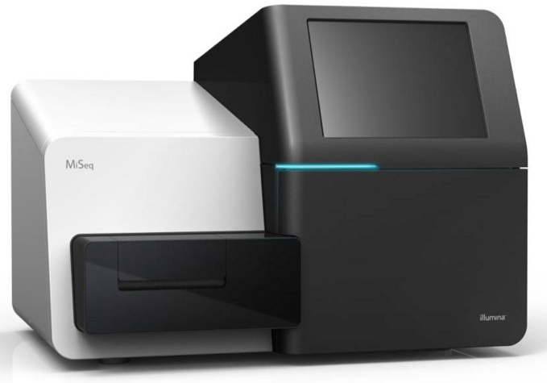
Library-on-library protein characterization
Counts

Slide 38
Library-on-library protein characterization
100
100
600
200
100
900
100
200
700

Slide 39
Library-on-library protein characterization
MATa
MATα
Sag1
LYS
LEU
LYS
LEU
pACT1
Z4EV
pZ4
CRE
pGPD
Aga1
pGPD
Aga1
Integrate the expression cassette
pGPD
mCherry
pGPD
mTurquoise
pGPD
Aga2:
a
α
:Aga2
pGPD

Slide 40
Test case for quantitative characterization
BCL2 apoptosis regulators (pro-survival)
Bfl-1
Bcl-B
Bcl-2
Bcl-xL
Bcl-w
Bad
αBFL1
F30D
αBCLB
BCDP01
10,000
de novo
binders
BECM04
αBCL2
1,000
2CDP06
XCDP07
K_{D} (nM)
100
Berger, Stephanie, et al. (2016) eLife 5: e20352.
10
1

Slide 41

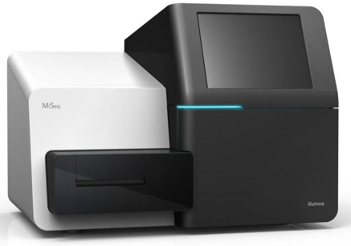
Library-on-library protein characterization
Combine cells of the same mating type with equal counts of each
Combine pooled mating types in YPD media
Incubate for 17 hours
+βE
Select for diploids and induce for CRE
Isolate genomic DNA and PCR barcodes
Read fragments with MiSeq and analyze

Slide 42

Library-on-library protein characterization
Bfl-1
αBFL1
FECM04
Bcl-B
αBCLB
BCDP01
BECM04
Batched Mating (%)
Bcl-2
αBCL2
2CDP06
10⁵
10³
10¹
10⁻¹
Bcl-xL
Affinity (nM)
XCDP07
Bcl-w

Slide 43

Library-on-library protein characterization
Bfl-1
αBFL1
Comparing pairwise and library-on-library
FECM04
Bcl-B
αBCLB
1:1
BCDP01
BECM04
Batched Mating (%)
Batched Mating Percent
Bcl-2
αBCL2
2CDP06
10⁵
10³
0.01
0.1
1
10
100
10¹
10⁻¹
Bcl-xL
Affinity (nM)
Pairwise Mating Percent
XCDP07
Bcl-w

Slide 44
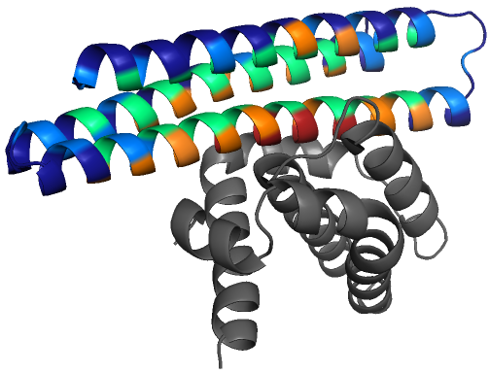
Mutagenesis library characterization
Using a partial SSM library of XCDP07 as a test case
Bcl-xL (Gray) bound to XCDP07
Why XCDP07? Favorable mutations for Bcl-xL binding have already been identified from sorting with conventional YSD
Berger, Stephanie, et al. (2016) eLife 5: e20352.

Slide 45
Mutagenesis library characterization
Using a partial SSM library of XCDP07 as a test case
SSM: Site-saturation mutagenesis
Bcl-xL (Gray) bound to XCDP07
Why XCDP07? Favorable mutations for Bcl-xL binding have already been identified from sorting with conventional YSD
Berger, Stephanie, et al. (2016) eLife 5: e20352.

Slide 46
Mutagenesis library characterization
Using a partial SSM library of XCDP07 as a test case
Bcl-xL (Gray) bound to XCDP07
Why XCDP07? Favorable mutations for Bcl-xL binding have already been identified from sorting with conventional YSD
Berger, Stephanie, et al. (2016) eLife 5: e20352.

Slide 47
Building large libraries
Match barcodes to their protein variant
Also get relative counts of each variant in the naïve library

Slide 48
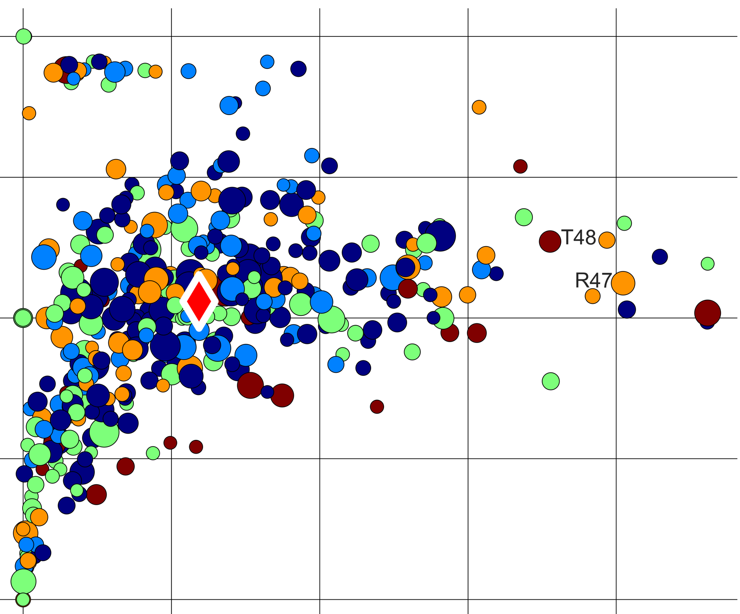
Mutagenesis library characterization
1
0.5
A48T
0
Specificity
L47R
-0.5
XCDP07 (native)
Core
Interface Core
Boundary
Interface Periphery
Surface
-1
0
0.5
1
1.5
2
Bcl-xL Interaction Strength
Bcl-xL Interaction strength: (# on target) / (# naïve)
Specificity: (on target %) – (highest off target %)

Slide 49
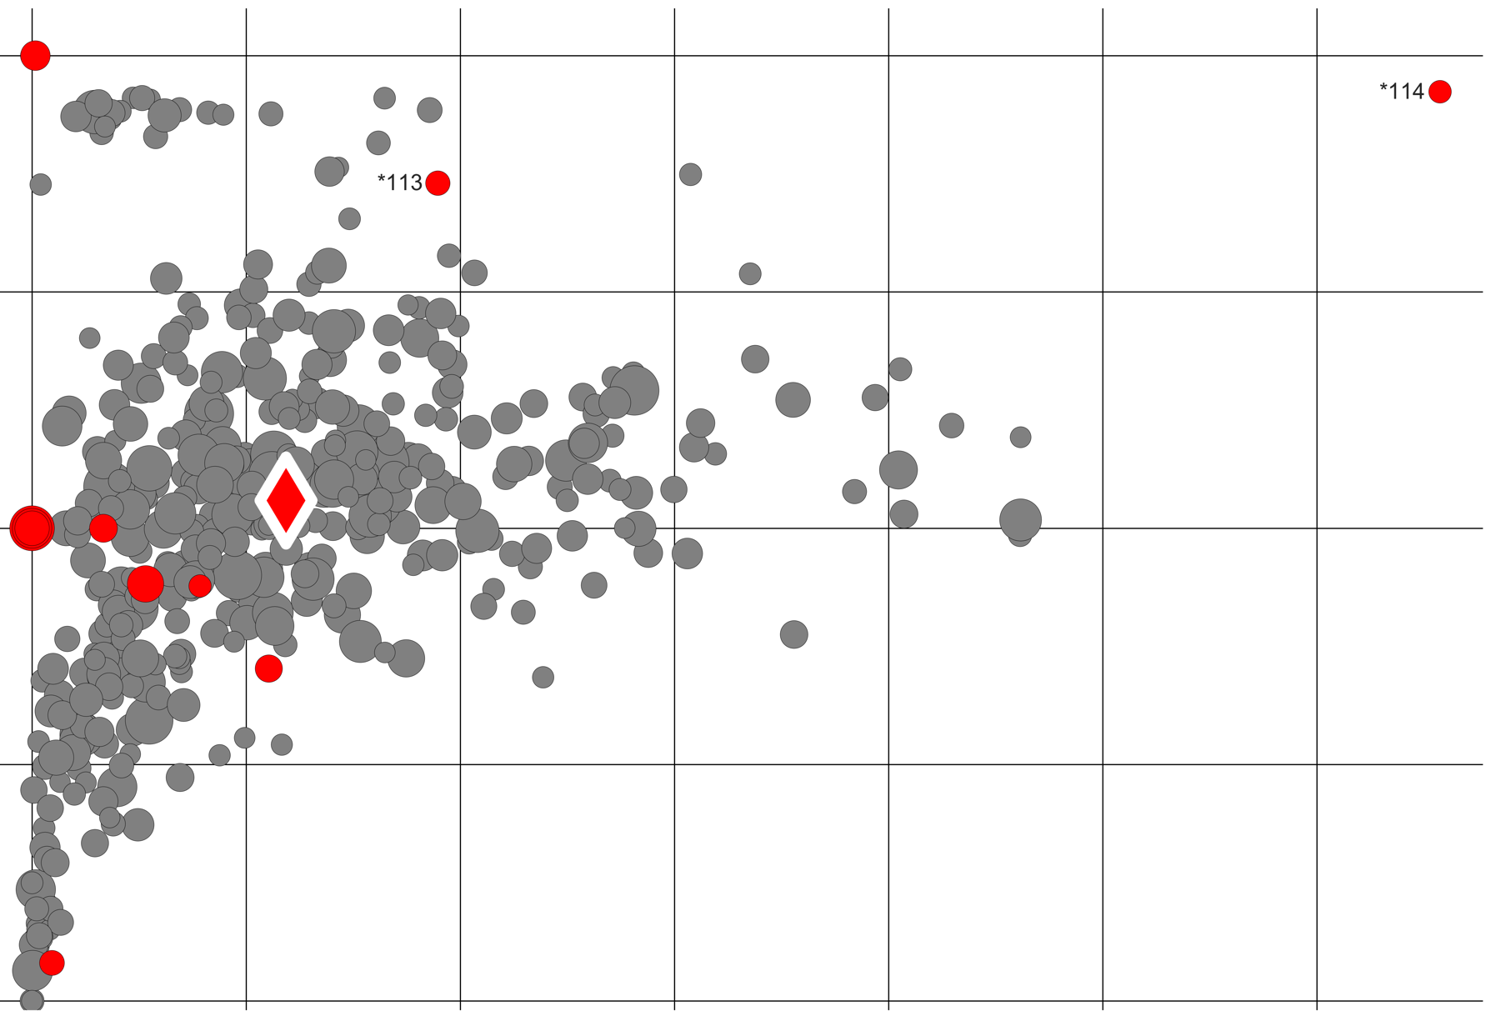
Mutagenesis library characterization
1
Test with early stop codons:
1
A48T
0.5
K113*
L114*
0.5
0
Specificity
L47R
0
Specificity
-0.5
XCDP07 (native)
Core
Interface Core
Boundary
-0.5
Interface Periphery
XCDP07 (native)
Surface
Early stop codon
-1
All other mutations
0
0.5
1
1.5
2
-1
Bcl-xL Interaction Strength
0
0.5
1
1.5
2
2.5
3
Bcl-xL Interaction Strength
Bcl-xL Interaction strength: (# on target) / (# naïve)
Specificity: (on target %) – (highest off target %)

Slide 50
Measuring response to environment changes

Slide 51
Measuring response to environment changes
Binding to
Bad.BH3 ( )
Interaction strength (au)
Bfl-1
Bcl-B
Bcl-2
Bcl-xL
Bcl-w

Slide 52

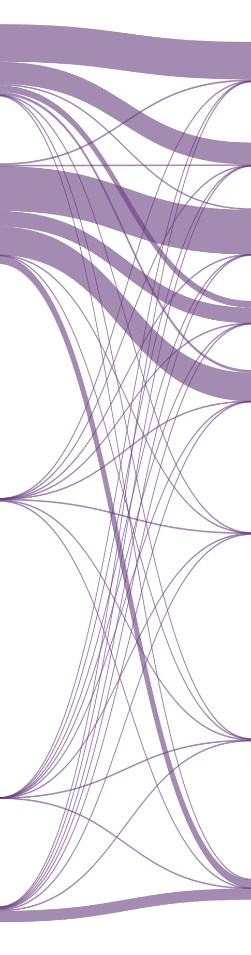
Measuring response to environment changes
0 μM Bad.BH3
100 μM Bad.BH3
Bfl-1
αBFL1
Bfl-1
αBFL1
FECM04
FECM04
Binding to
Bad.BH3 ( )
Bcl-B
αBCLB
Bcl-B
αBCLB
BCDP01
BCDP01
BECM04
BECM04
Interaction strength (au)
Bcl-2
Bcl-2
αBCL2
αBCL2
2CDP06
2CDP06
Bfl-1
Bcl-B
Bcl-2
Bcl-xL
Bcl-w
Bcl-xL
Bcl-xL
XCDP07
XCDP07
Bcl-w
Bcl-w

Slide 53

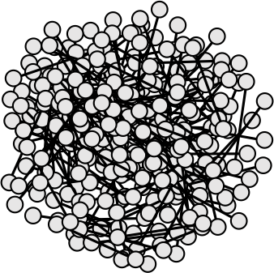
Drug Screening
?
?
?
?
?
?
Many drugs act by blocking or enhancing specific protein interactions
If other interactions are affected, the drug may cause side-effects
Before clinical trials, a small fraction of interactions are tested

Slide 54
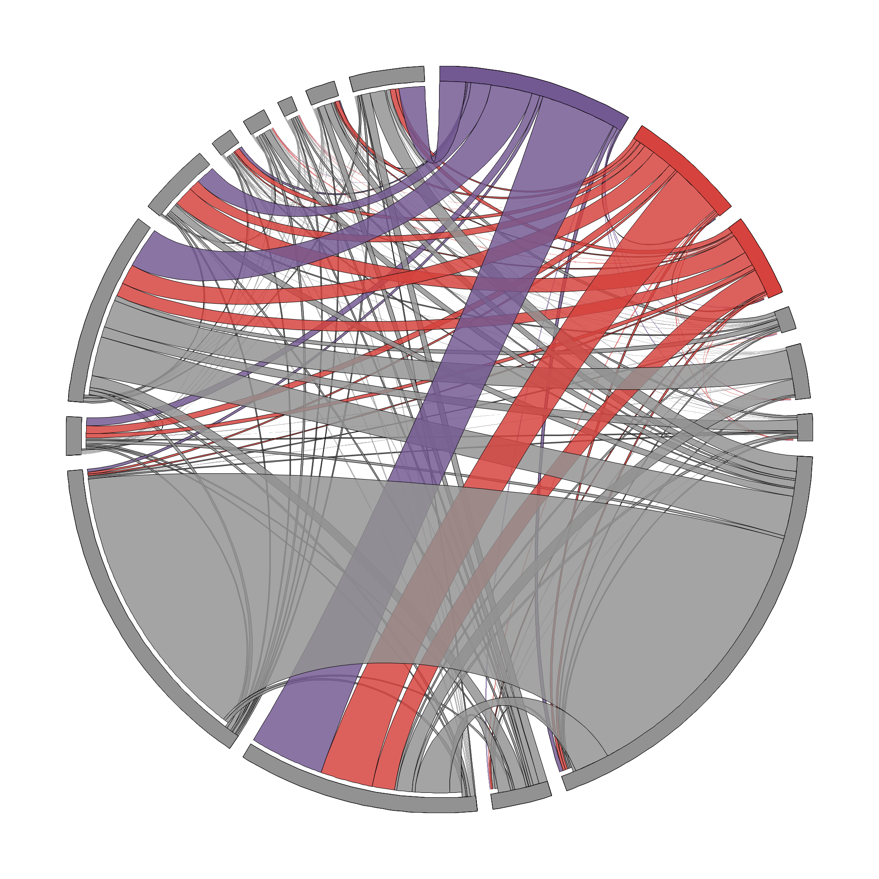
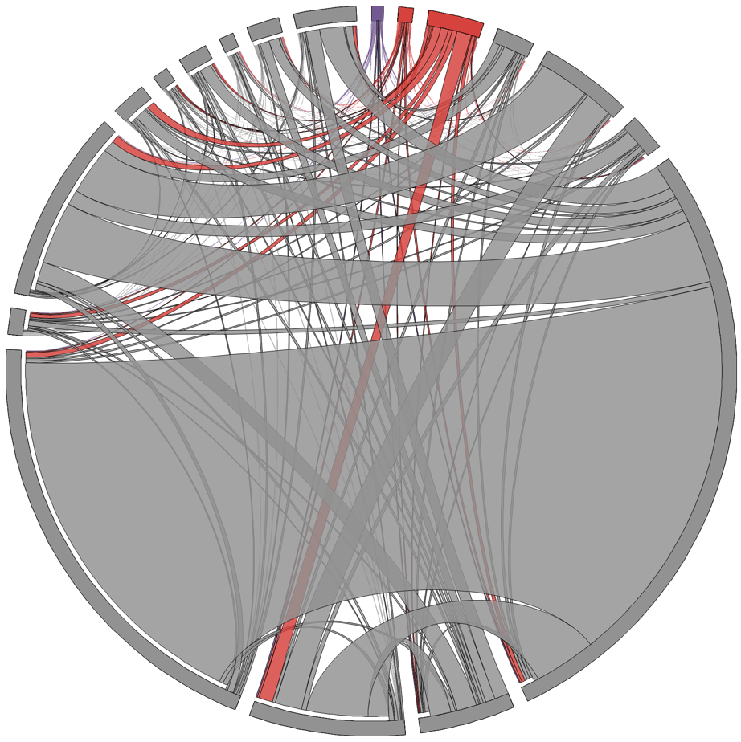
Navitoclax (CLL): a Disruptor with Off-Target Interactions
Bop
Bax
Bok
Bak
Bcl-2
Bad
Bcl-xL
Bik
Bcl-w
Bim
Bcl-B
BHRF
Bmf
No Drug
Mcl-1
100 nM Navitoclax
Noxa
Bfl-1
Puma
mBfl-1
On-target PPI
Off-target PPIs
Other PPIs
David Younger et al, unpublished
Notes:
Venetoclax (INN,^{[3]} trade name Venclexta /vɛnˈklɛkstə/ ven-KLEKS-tə in the US^{[2]} and Venclyxto in Europe) is a small moleculeoral drug that treats chronic lymphocytic leukemia (CLL) in those with a specific chromosomal abnormality.^{[4]} In 2015, the United States Food and Drug Administration (FDA) granted Breakthrough Therapy Designation to venetoclax for subjects with CLL who have relapsed or have been refractory to previous treatment and have the 17p deletion genetic mutation.

Slide 55
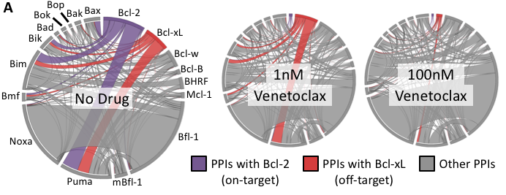
Venetoclax: No Off-Target Interactions (at relevant dosage)
David Younger et al, unpublished

Slide 56
On and Off Target Suppression
Bcl-2 Interactions
Bcl-w Interactions
Bcl-xL Interactions
100pM
10nM
ABT199
(Venetoclax)
100nM
1nM
1nM
ABT263
(Navitoclax)
100pM
1µM
1nM
ABT737

Slide 57
Rapalogs are Enhancers
rapamycin
FKBP12
FRB
Rapamycin
Everolimus
K_{d}=0.2 nM
K_{d}=26 µM
Ridaforolimus
K_{d}=12 nM
K_{d}=100 fM
David Younger et al, unpublished
Notes:
AlphaSeq is also used to measure changes that enhance protein interactions. As a test case, the interaction between FKBP12 and FRB was tested with 3 rapalogs. FKBP12 was expressed on MATa and FRB was expressed on MATα. Mating efficiency was measured at a concentration range and the expected dose response was observed.

